Slide 1
Breast Cancer
Predicting Hope
A Machine Learning Approach to Breast Cancer Survival
By Sai Vyshnavi Gudipalli

Slide 2
Agenda
1
2
3
Introduction
Descrptive Analysis
Data Descrption
4
5
6
Literature Review
Statistical Methodologies
Results

Slide 3
1
Introduction

Slide 4

What is Breast Cancer?
Breast Cancer:
Breast cancer is a type of cancer that begins in the cells of the breast.
It most often starts in the milk ducts (glands that produce milk) of the breast tissue.
Cancerous cells in the breast can spread to other parts of the body, which is known as metastasis.
Types of Breast Cancer:
Invasive Ductal Carcinoma (IDC): The most common type; starts in the ducts and spreads to surrounding tissue.
Invasive Lobular Carcinoma (ILC): Starts in the lobules and can spread.
Ductal Carcinoma In Situ (DCIS): A non-invasive form that remains within the milk ducts.
Inflammatory Breast Cancer: A rare but aggressive form, causing redness and swelling.

Slide 5

Symptoms of Breast Cancer
A lump in the breast or underarm.
Change in the size or shape of the breast.
Unexplained pain in the breast or nipple.
Skin changes, such as redness, dimpling, or puckering.
Unusual discharge from the nipple, possibly with blood.

Slide 6
Objective
The main goal of this analysis was to predict whether a person would survive for 5 years or not after being diagnosed with breast cancer.
Models Used:
Logistic Regression
Neural Network
Decision Tree

Slide 7
Research Question
Can we accurately predict the 5-year survival of breast cancer patients using clinical and demographic variables from the dataset?

Slide 8
2
Data Description

Slide 9
Source: SEER (Surveillance, Epidemiology, and End Results) Program – a reliable and comprehensive source of U.S. cancer statistics.
Dataset Size: Total Records: 701,163 breast cancer patient entries
Variables Used in the Analysis:
Age_recode_with_1_year_olds – Patient’s age at diagnosis (1-year increments)
Breast_Subtype_2010 – Classification of breast cancer subtype
Race_recode – Race of the patient
Sex – Gender of the patient
Grade_Recode – Tumor grade (differentiation level)
Chemotherapy_recode – Whether the patient received chemotherapy
Radiation_recode – Whether the patient received radiation treatment
Mets_DX_Distant_LN – Presence of distant lymph node metastasis
Mets_DX_Other – Presence of other distant metastases
Marital_status – Marital status of the patient
survived_5yr – Target variable: Whether the patient survived at least 5 years (0 = No, 1 = Yes)

Slide 10
Preprocessing of the Data
There are 701,163 rows and 82 columns in our data set.
Columns like "Grade Recode (thru 2017)" and "RX Summ--Surg Prim Site (1998+)" have a large number of missing values (e.g., over 250,000). Others like "Survival months" have fewer missing values (e.g., ~3,398). Some columns like "Sex", "Year of diagnosis", and "Primary Site" have no missing values.
Some columns like "Schema Discriminator 2: Oropharyngeal p16 (2018+)", "KRAS (2018+)", and many others have 100% missing values – this means there's no data at all for these columns. So I dropped them.
Then I did imputation ,
Imputation: Filling missing values with an estimated value based on the other data in the dataset. , Imputed missing values with the median for numeric columns and Imputed missing values with the mode for categorical columns.
I checked if any columns still have missing values , I got named numeric(0) indicating that there are no remaining columns with missing values. this means that all missing values have been successfully handled.

Slide 11
3
Descrptive Analysis

Slide 12
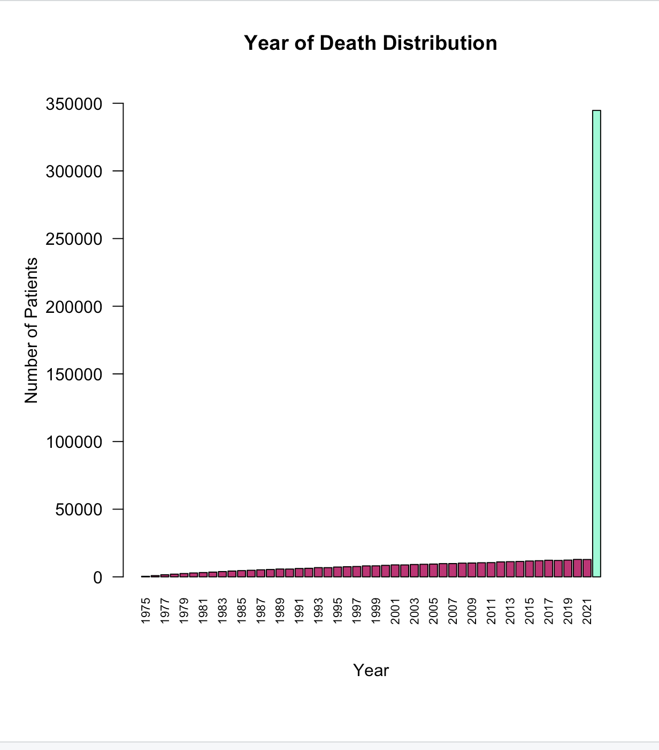
Year of Death Distribution
The bar chart displays the number of patients who died each year from 1975 to 2022 based on SEER breast cancer data.
The red bars represent patients who died in specific years.
The green bar represents those marked as "Alive at last contact", which shows a significant count.
Alive at Last Contact : 344,714 patients were alive at their last recorded follow-up.
Peak Years: The late 2010s to 2020 saw the highest recorded deaths.
Deaths Over Time:
Death counts show a steady rise from 1975 to 2020:
1975: Only 393 recorded deaths
2000: Around 8,500 deaths
2020: Nearly 12,894 deaths
A sharp spike in 2022 is observed with a green bar, but this bar represents those alive.

Slide 13
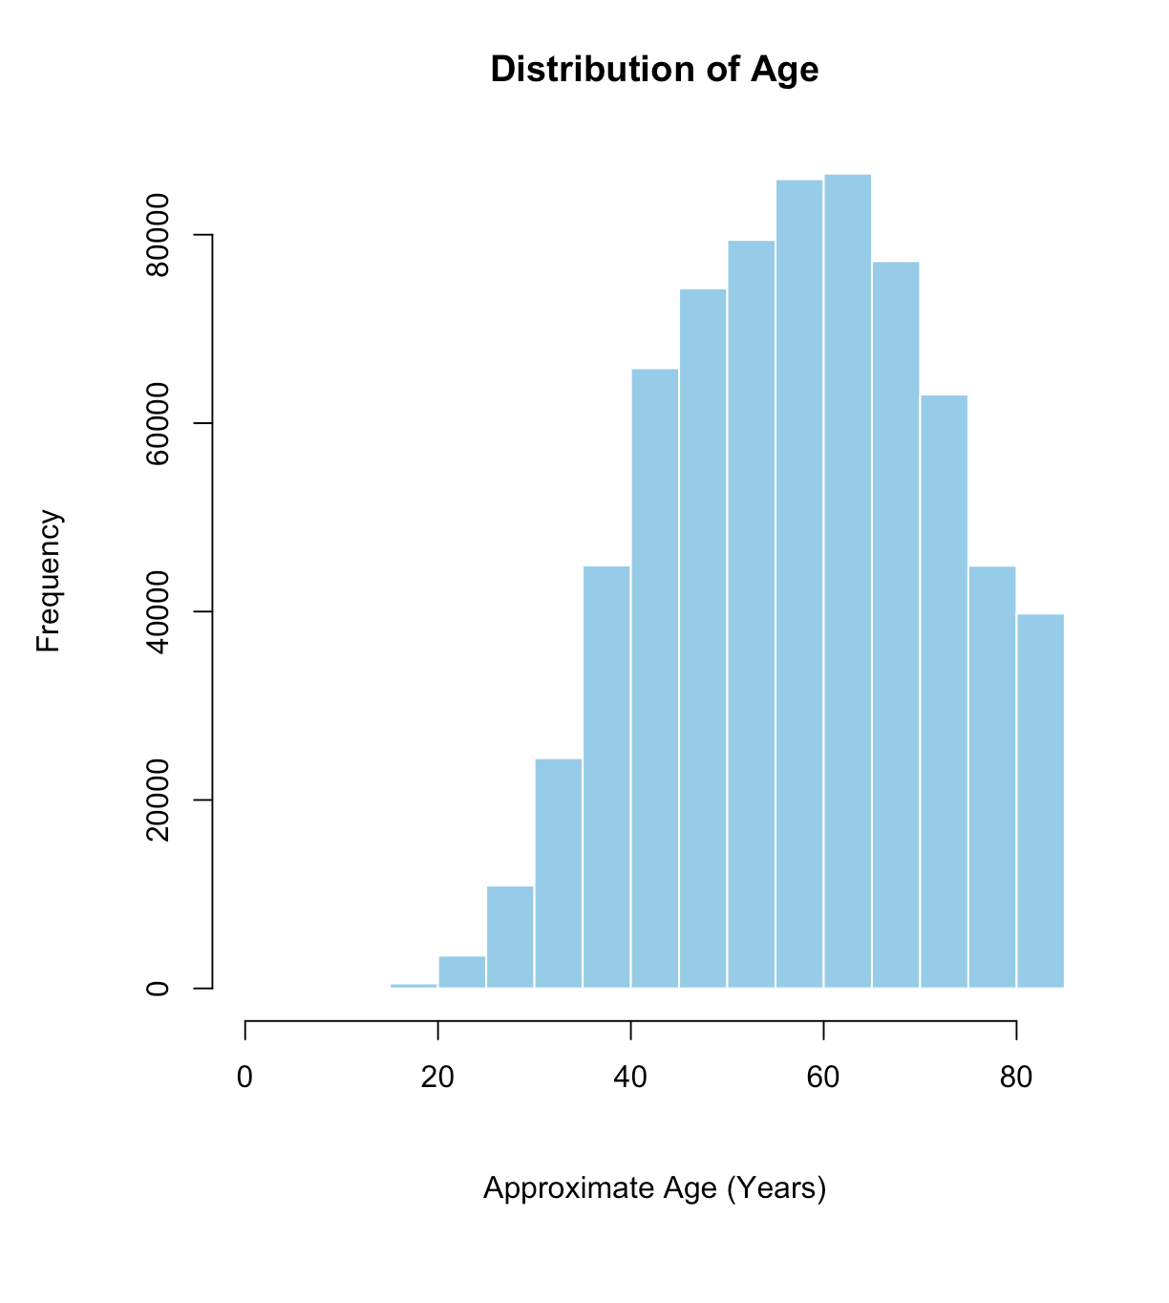
Distribution of Age
The histogram displays the frequency distribution of patient ages in the breast cancer dataset.
The x-axis represents patient age (approximate, in years), ranging from 0 to 85+.
The y-axis shows the number of patients within each age group.
The age distribution is approximately normal, with:
A peak around 50 years.
A significant portion of patients concentrated between 40 to 65 years.
Fewer cases are observed at the extremes (under 30 and over 75).
This suggests that middle-aged to older adults (especially women in their 40s to 60s) are the most affected group in this dataset.

Slide 14
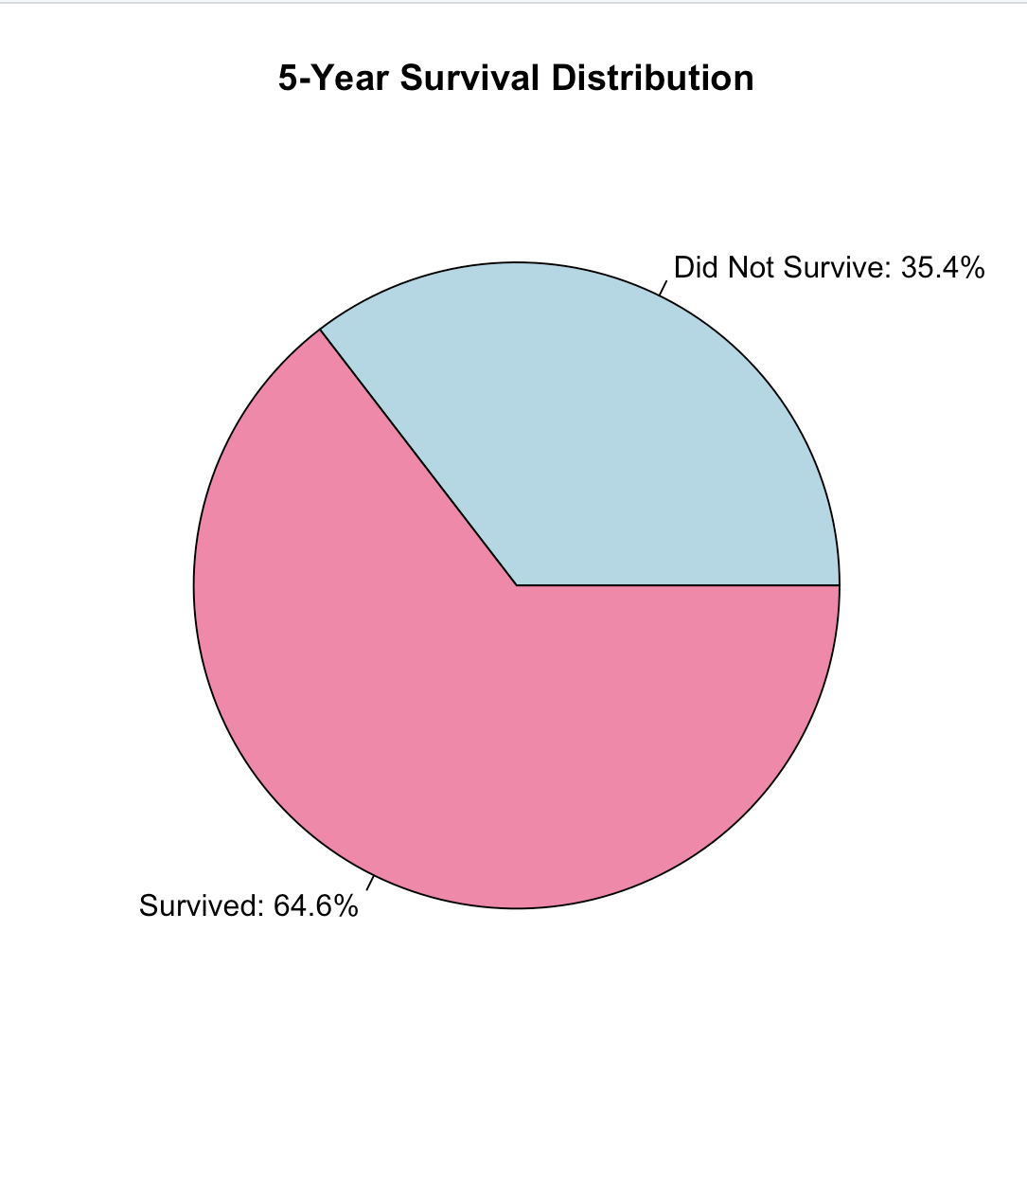
5-Year Survival Distribution
The pie chart shows how many patients survived for at least 5 years after being diagnosed with breast cancer, based on the dataset.
64.6% of the patients survived for 5 years or more (represented in blue).
35.4% of the patients did not survive for 5 years (represented in red).
A majority of patients in this dataset were able to survive at least 5 years after diagnosis.
However, a significant portion (over one-third) still did not reach the 5-year survival mark, which shows that breast cancer can still be life-threatening for many individuals.

Slide 15
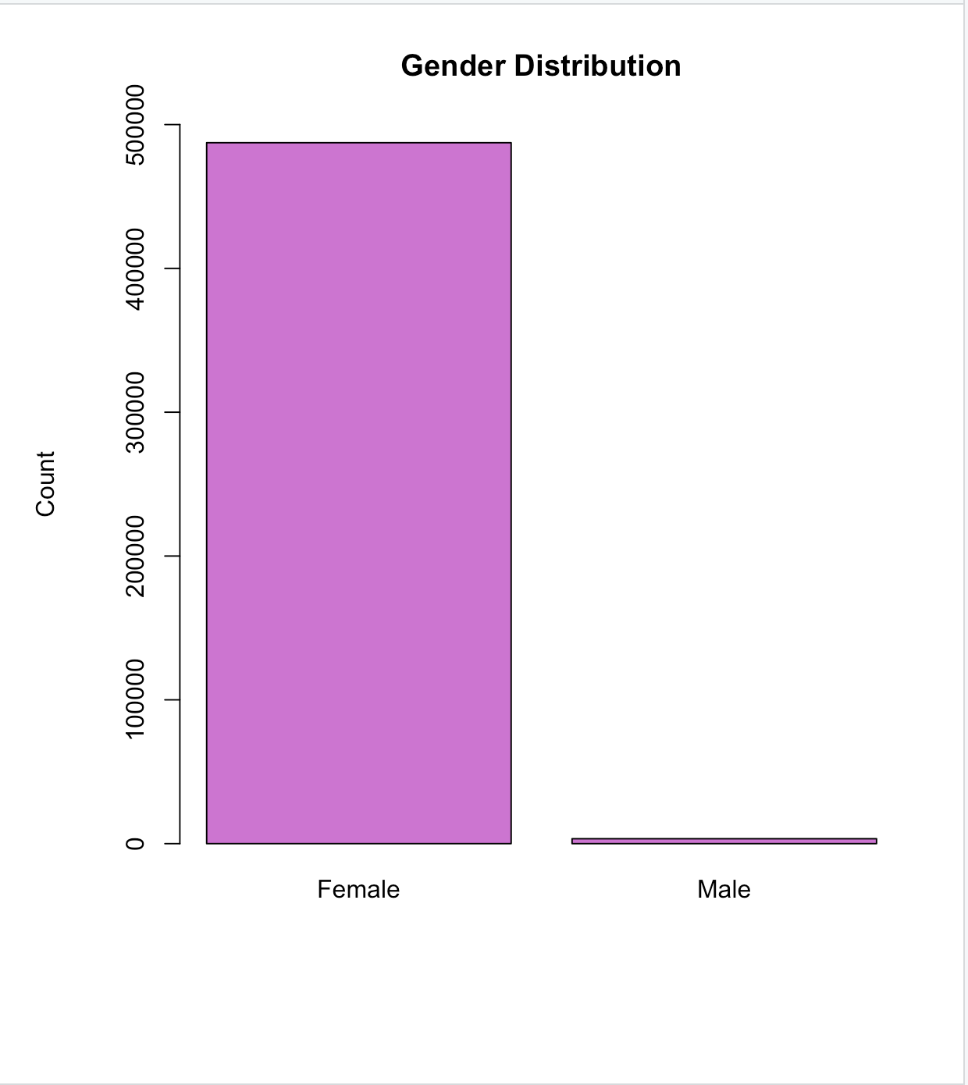
Gender Distribution
This bar plot displays the gender distribution of the patients in the breast cancer dataset.
I found that while breast cancer is much more common in women, it can also be seen in men. Even though the number of male patients is very small compared to females, this shows that men can also get breast cancer, and it's important not to ignore that risk.
There are Female: 487,393 and Male: 3,422

Slide 16
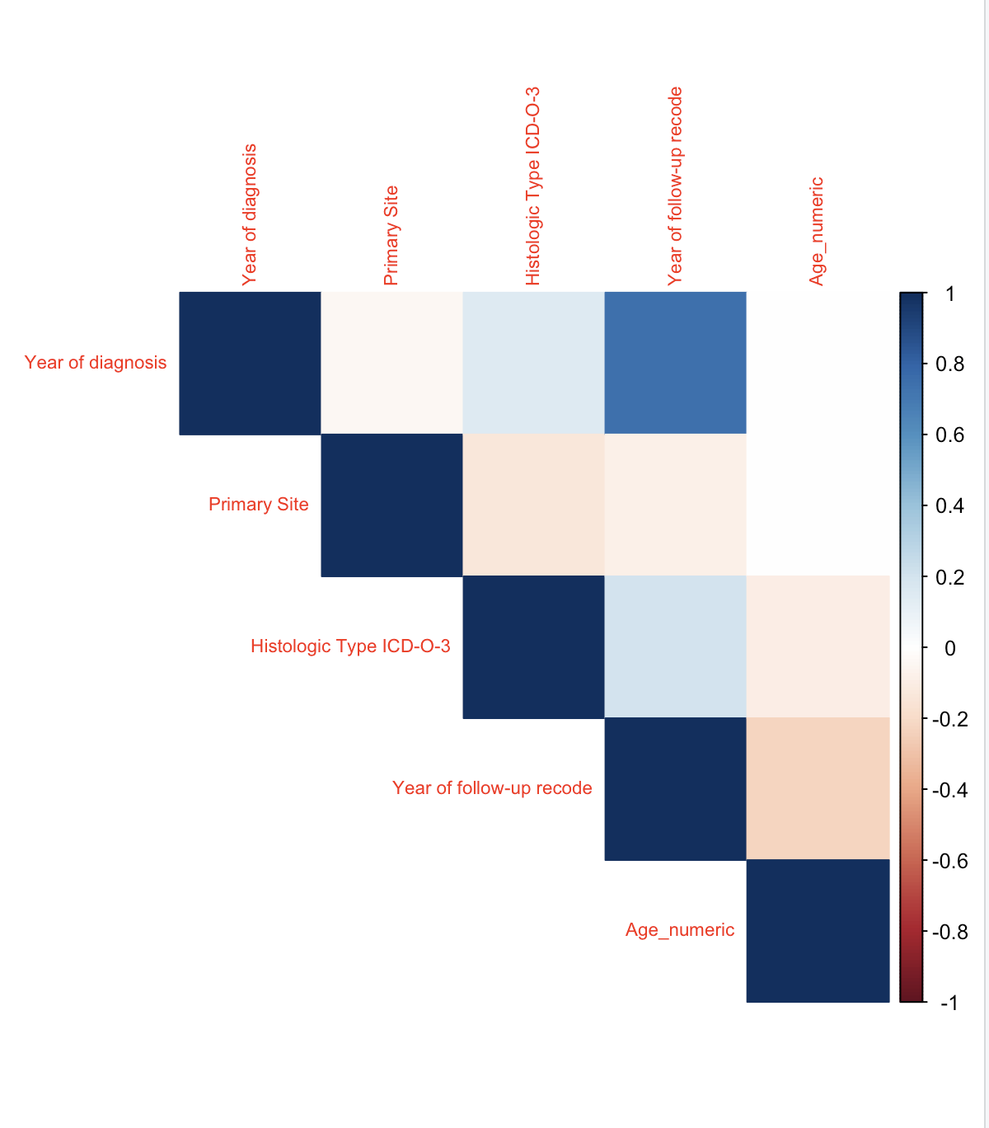
correlation heatmap
The image shows a correlation heatmap, visually representing the relationships between several variables.
+1 represents positive correlation and –1 indicates a perfect negative correlation.
Year of diagnosis and Age_numeric:
The dark blue cell indicates a strong positive correlation. This suggests that as the year of diagnosis increases, the age of the patients tends to increase as well. For example, patients diagnosed in 2020 might be older on average than those diagnosed in 2010.

Slide 17
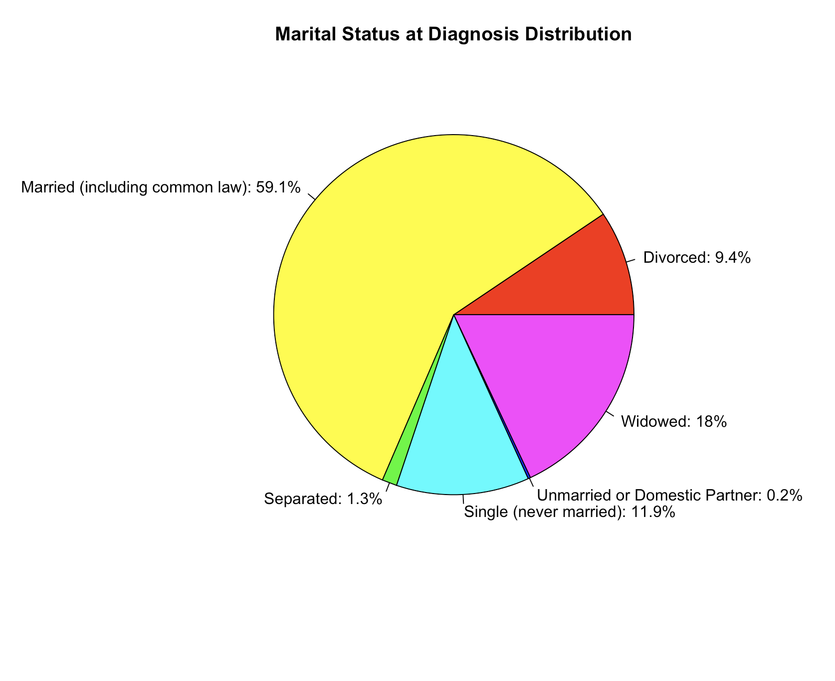
Marital Status at Diagnosis
This pie chart provides insights into the relationship status of breast cancer patients at the time they were diagnosed.
Majority Married: The largest group (59.1%) were married.
Widowed Patients (18%)
11.9% of patients were single
9.4% were divorced
Separated: 1.3%
Unmarried or Domestic Partner: 0.2%
This data may be useful for researchers or healthcare providers to design targeted support programs based on the marital or social support system available to patients.

Slide 18
4
Literature Review

Slide 19
Dr. Eleni Chatzaki (2015): Research Focus: Breast Cancer Prediction Models using Machine Learning
Dr. Eleni Chatzaki and colleagues explored the application of machine learning techniques, such as decision trees, support vector machines, and artificial neural networks, to predict breast cancer outcomes. In her study, she developed a predictive model that incorporated factors such as tumor size, lymph node status, and patient age. Her work found that machine learning algorithms could significantly improve breast cancer diagnosis, providing more accurate and earlier detection compared to traditional methods. Her research has been influential in highlighting the potential of machine learning in medical diagnostics and is a critical reference for understanding predictive models in healthcare
Dr. Anita Bahl (2020): Research Focus: Early Detection and Imaging Techniques in Breast Cancer
Dr. Bahl’s research emphasizes the role of advanced imaging technologies such as mammography, ultrasound, and MRI in the early detection of breast cancer. In collaboration with other researchers, she has also explored how combining imaging techniques with predictive modeling could improve diagnostic accuracy. Her findings suggest that AI-driven imaging analysis could significantly aid in detecting cancer at earlier stages, especially in challenging cases where traditional methods might miss subtle signs of disease (Bahl et al., 2020). Her work has been pivotal in advancing the use of AI in diagnostic imaging and is highly relevant for understanding how technology can aid in breast cancer prediction.

Slide 20
Dr. Michael Giordano (2020): Research Focus: Gender Disparity in Breast Cancer Diagnosis
Dr. Giordano has contributed significantly to understanding the gender disparity in breast cancer, specifically focusing on male breast cancer, which accounts for less than 1% of all breast cancer cases. His research highlights the delayed diagnosis in men due to the low incidence rate and lack of awareness. In his study, Giordano stressed the importance of raising awareness about breast cancer in men and emphasized the need for gender-inclusive predictive models in breast cancer research. His work provides essential insights into the limitations of existing predictive models that often underrepresent male breast cancer cases, making his research highly relevant to understanding gender disparities in breast cancer detection (Giordano et al., 2020).
Dr. Nandi R. (2020): Research Focus: Decision Trees in Breast Cancer Classification
Dr. Nandi’s research on decision trees for classification problems in breast cancer prediction has been groundbreaking. Decision trees are a popular tool due to their interpretability and ability to model complex decision-making processes. Dr. Nandi's study applied decision tree algorithms to breast cancer datasets, specifically focusing on the identification of key features like tumor size, grade, and family history that contribute to the likelihood of breast cancer recurrence. The results showed that decision trees could provide transparent decision-making pathways for healthcare professionals, leading to more effective and interpretable models for patient diagnosis (Nandi et al., 2020).

Slide 21
5
Statistical Methodologies

Slide 22
Logistic Regression
Logistic Regression is a statistical model used for binary classification problems. It predicts the probability that a given input belongs to a particular class (e.g., survived or not survived over 5 years).
Accuracy = 72.61% :The model correctly predicted the outcome in 72.6% of the cases.
Precision = 75.34% : Of all patients predicted to survive 5 years, 75.34% actually did.
Recall = 85.60% :Of all actual survivors, the model correctly identified 85.6%.(Shows how well the model captures actual positives.)
F1-Score = 80.14% :A balanced metric combining precision and recall — shows strong predictive power.
True Negatives (67,980): Model correctly predicted 85,108 non-survivors.
False Negatives (44,445): Model missed 45,643 actual survivors.
False Positives (105,931): Model wrongly 88,803 predicted survival.
True Positives (272,459): Model correctly 271,261 predicted survivors.

Slide 23
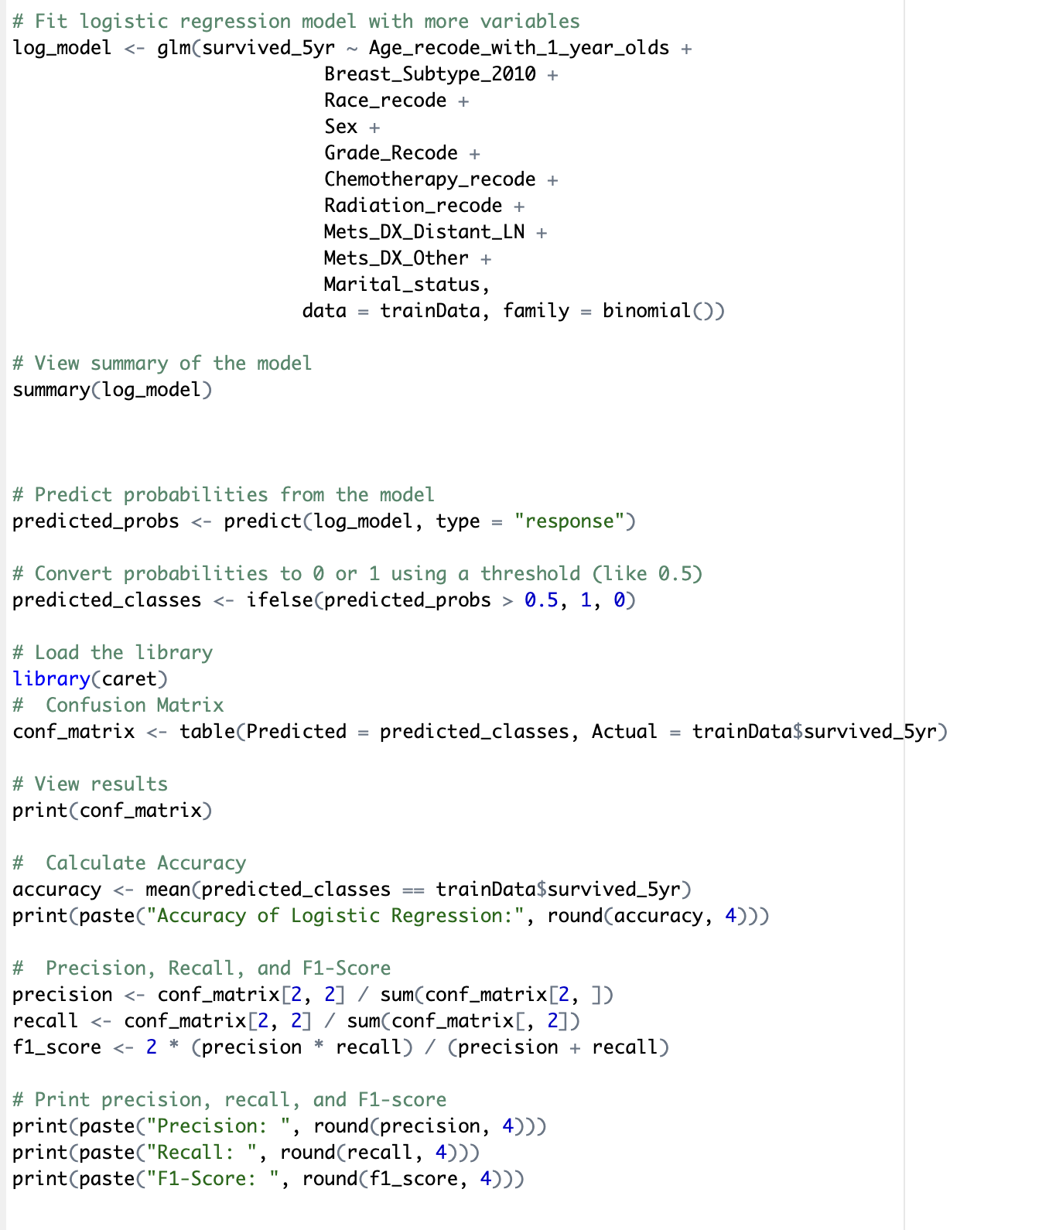
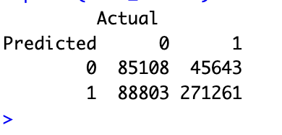

Slide 24
Neural Network
A Neural Network is a machine learning model inspired by the human brain. It is especially powerful for detecting complex patterns and relationships in data. Here, it was used to classify whether a breast cancer patient would survive 5 years or not.
​
Accuracy = 74.20% :The model correctly predicted outcomes for 74.2% of the training data. This is slightly higher than the logistic regression model
Precision = 76.93% Of all patients the model predicted would survive 5 years, 76.93% actually did.
Recall = 85.75% The model correctly identified 85.75% of actual 5-year survivors. F1-Score = 81.10% This score balances precision and recall, and a value over 0.8 is considered strong — indicating the neural network handles classification well overall.
True Negatives (92,355): Model correctly predicted 93,043 patients as non-survivors.
False Negatives (45,166): Model wrongly predicted 45,614 patients as survivors (but they did not survive).
False Positives (81,556):Model missed 80,868 actual survivors by predicting them as non-survivors.
True Positives (271,738): Model correctly predicted 271,290 patients as survivors

Slide 25
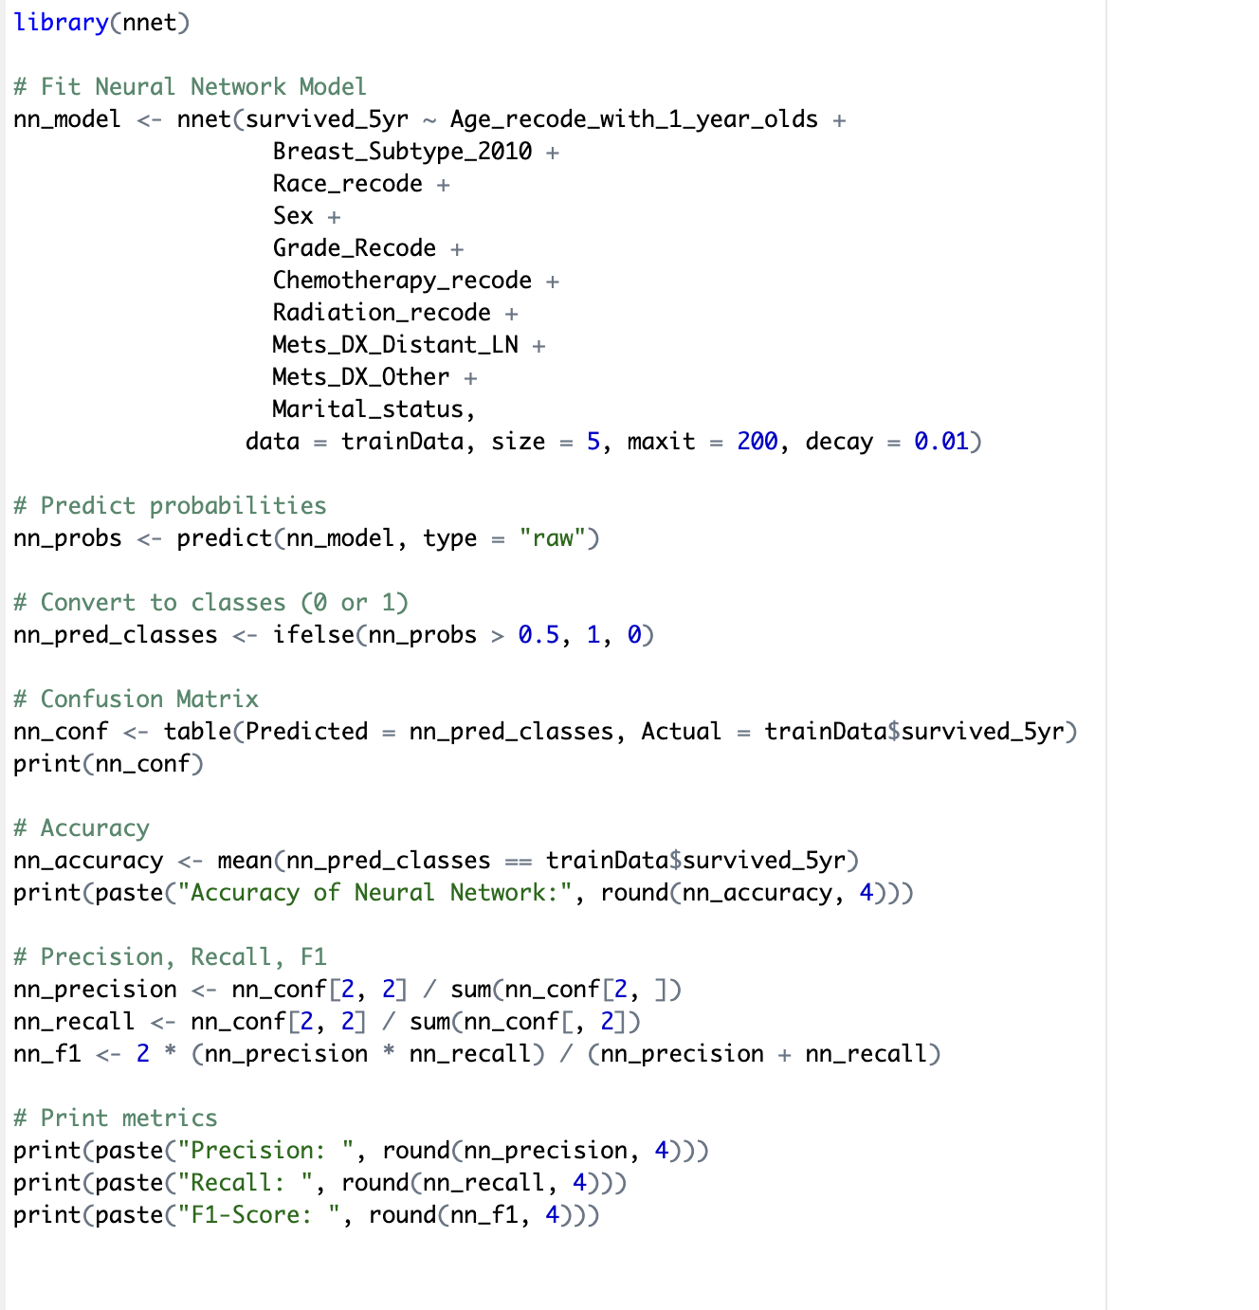
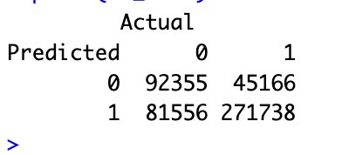

Slide 26
Decision Tree
A Decision Tree is a supervised machine learning algorithm used for classification and regression tasks. It splits the data into branches based on feature values and helps in making decisions in a tree-like structure.
​Accuracy: 73.81% – The model correctly predicted survival outcomes 73.81% of the time.
Precision: 76.03% – Out of all patients predicted to survive, 76.03% actually did.
Recall: 86.81% – The model correctly identified 86.81% of patients who survived.
F1-Score: 81.06% – Balanced performance combining precision and recall.
True Negatives (87,184): Model correctly predicted 87,184 patients as non-survivors.
False Negatives (41,813): Model wrongly predicted 41,813 patients as survivors (but they did not survive).
False Positives (86,727): Model missed 86,727 actual survivors by predicting them as non-survivors.
True Positives (275,091): Model correctly predicted 275,091 patients as survivors.

Slide 27
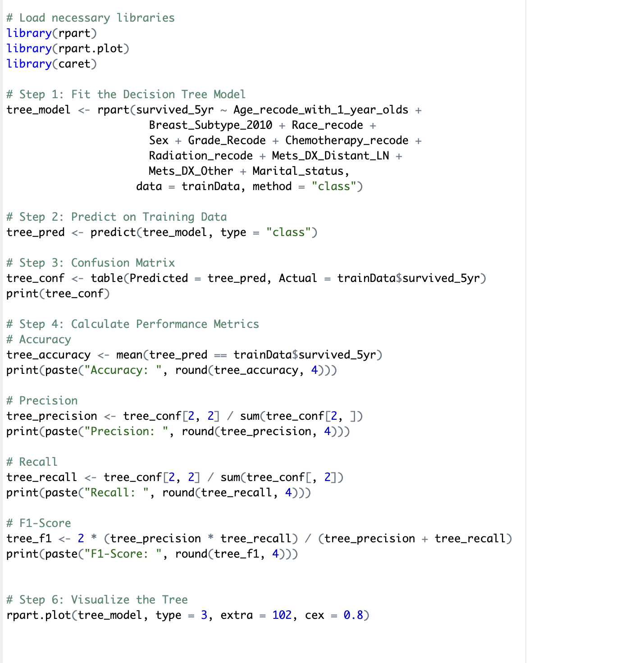
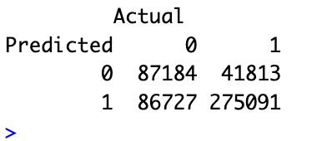

Slide 28
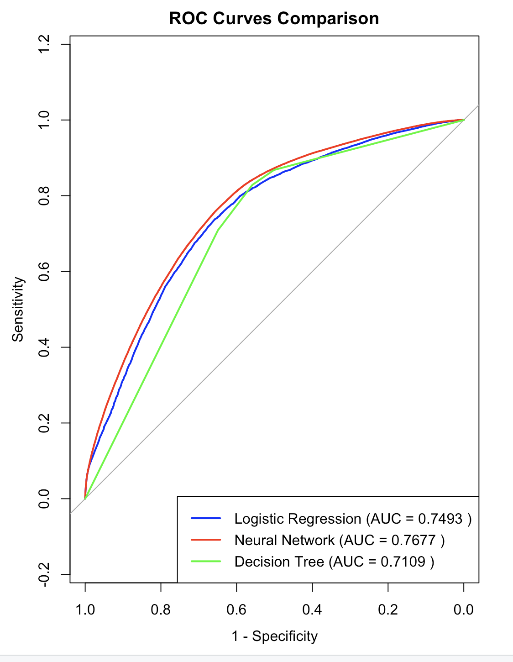
ROC &AUC
The ROC (Receiver Operating Characteristic) curve shows how well our model can distinguish between two classes (in our case, survived_5yr = 0 or 1) by plotting:
True Positive Rate (TPR) = Sensitivity
False Positive Rate (FPR) = 1 - Specificity

Slide 29
6
Results

Slide 30
Metric | Logistic Regression | Neural Network | Decision Tree
Accuracy | 72.61% | 74.20% | 71.45%
Precision | 0.7534 | 0.7693 | 0.7601
Recall | 0.8560 | 0.8575 | 0.7605
F1 Score | 0.8014 | 0.8110 | 0.7603
AUC Score | 0.7493 | 0.7677 | 0.7109

Slide 31
Interpretation of Results
Neural Network performs the best overall across all key metrics — highest accuracy, precision, recall, F1-score, and AUC.
Logistic Regression is a strong baseline model with solid performance but slightly below the neural network in all areas.
Decision Tree shows the lowest performance, especially in AUC and accuracy, though it's still better than random guessing.

Slide 32

Thanks!

